Slide 1
Ocean basin Animation
CSCI 2230 Final project
Bitao Jin, Ella Liang, Renhao Zhang, Joel Kim

Slide 2
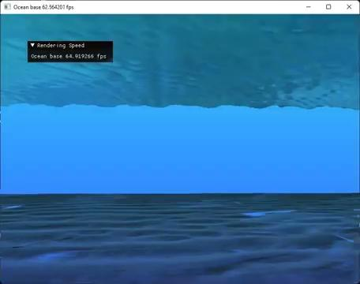
Result1:
PLAY

Slide 3
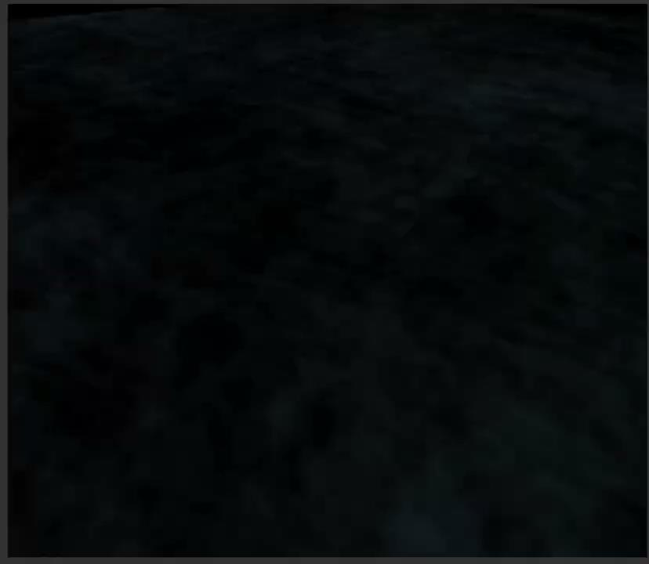
Result2 Caustics ray
PLAY

Slide 4
Outline -- features
Sand: Normal and parallax occlusion mapping
Waves: Procedural generated waves || Wave normal mapping
Caustics ray: Projection of procedural generated waves and blend
Deep sea filter: Frame buffering post-processing

Slide 5
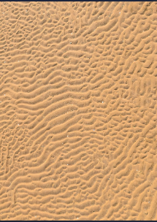
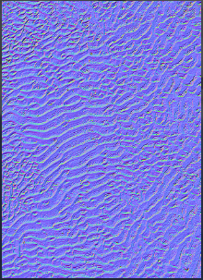
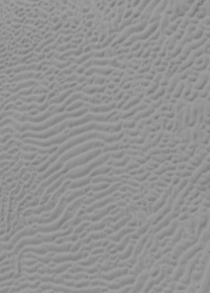
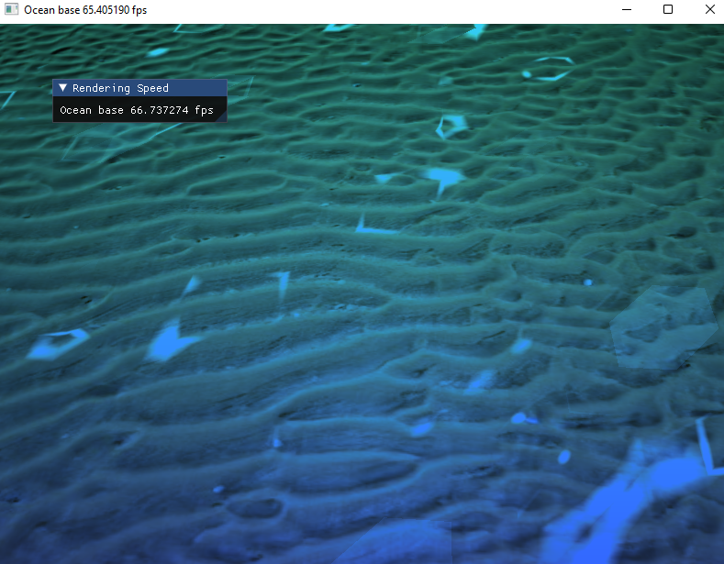
Feature 1: Sand (seabed)
Diffusion texture
Normal texture
Displacement texture
1. Quad render with diffusion texture
Generate a 2-triangle quad with texture
2. Generate normal textures and add normal map
3. Generate displacement textures and add parallax map
Here we use this online tool to generate textures and adjust parameters:
https://cpetry.github.io/NormalMap-Online/
4. Add normal and parallax mapping into shader
Here we followed :
https://learnopengl.com/Advanced-Lighting/Parallax-Mapping
https://learnopengl.com/Advanced-Lighting/Normal-Mapping
Result:

Slide 6

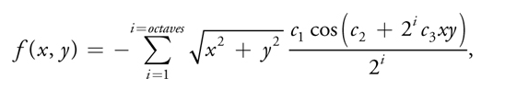
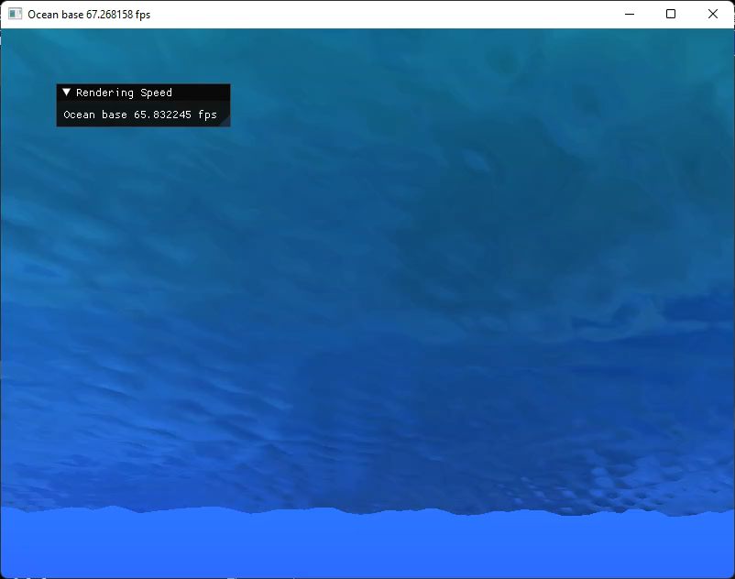
Feature 2: Procedural generated waves
We used basic TRIANGLE_STRIP to run OpenGL draw call.
The waves is an overlay of set of trigonometric functions.
We followed the guide of GPU Gem1
The waves function is generated following:
The skybox environment texture mapping
is also been considered.
Result: PLAY

Slide 7
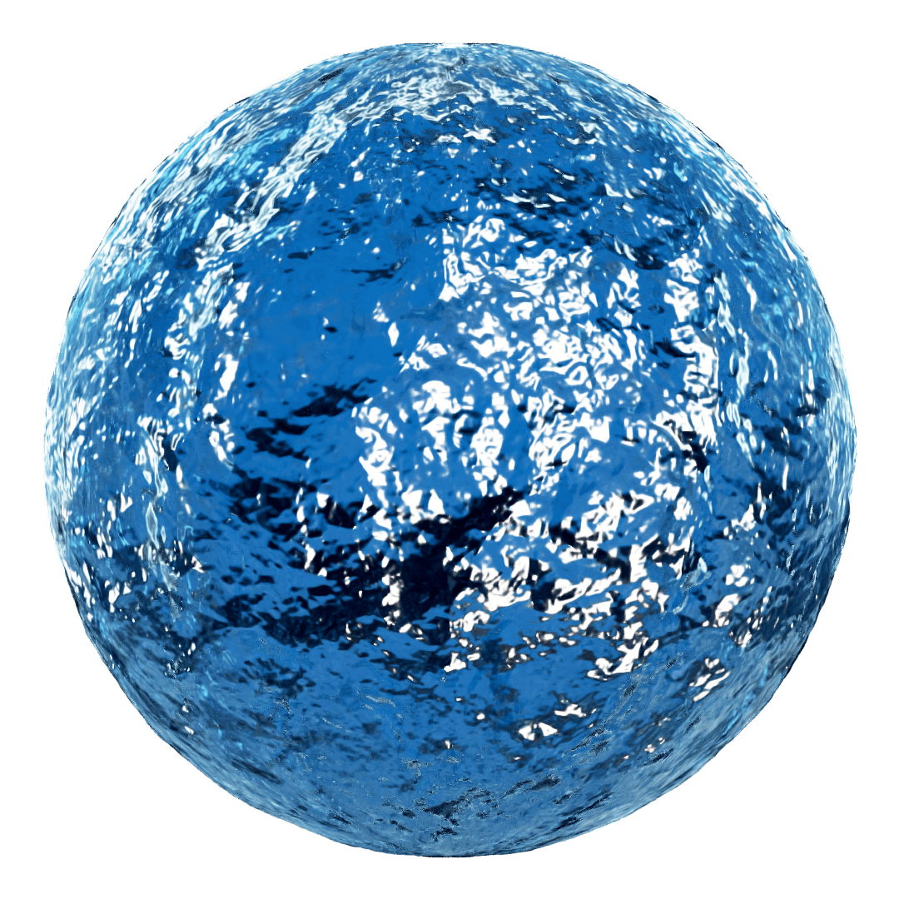
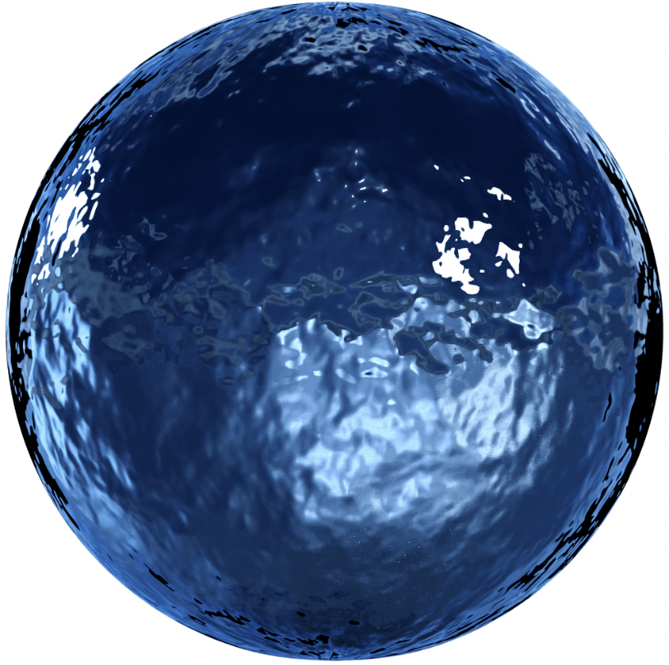
Feature 2: Waves Normal Mapping
Besides the procedurally generating waves, we also tried to map the normal of ocean surface from the real world.

Slide 8
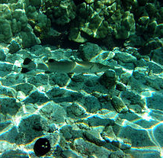
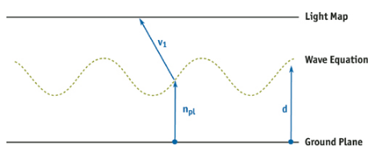

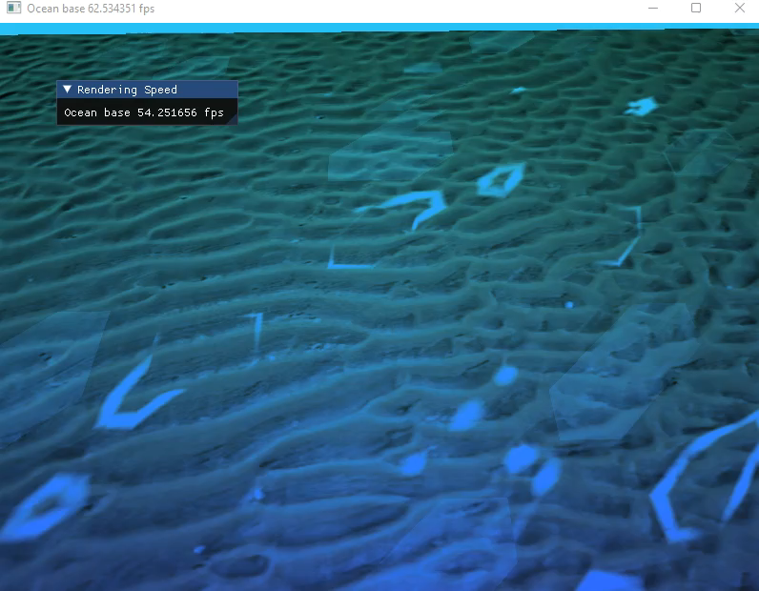
Feature 3: Caustics ray
Caustics ray is a major feature to process water simulation.
This feature is by enabling the OpenGL Blend, and render
A virtual procedural generated wave the same as top waves
which lay on the ocean basin level. A ray is then cast in the set direction and test intersection with ocean basin plane.
Result point will be counted as vertex of
TRIANGLE_STRIPE,
and add light texture.
Result: PLAY
Environment map of sunlight

Slide 9
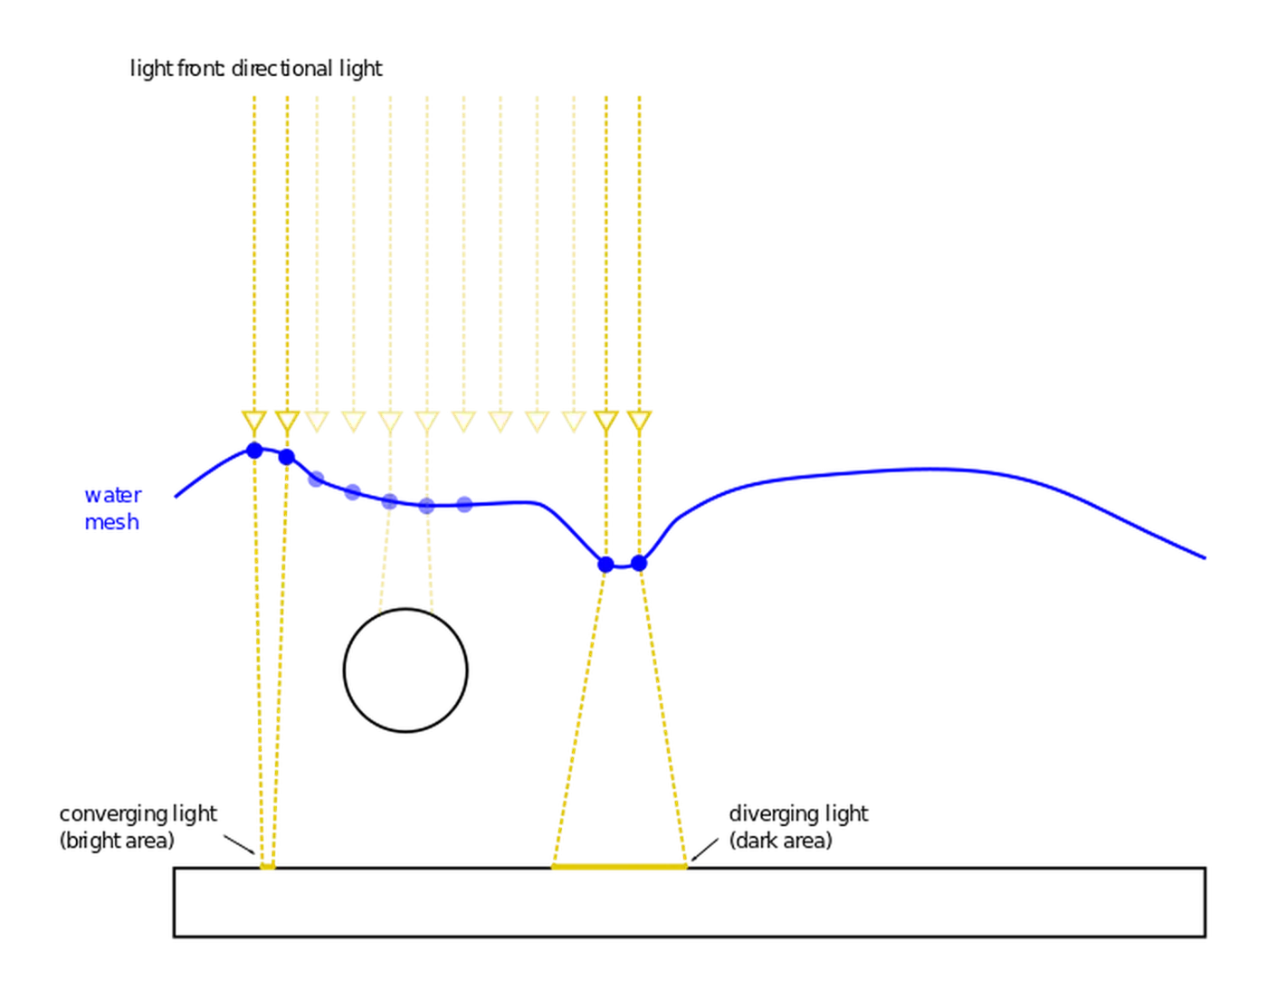
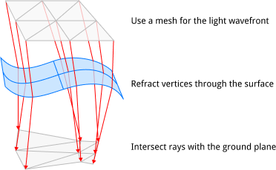
Feature 3: Caustics ray
Generating caustics ray consists three parts:
Compute the reflected ray
Compute the position the ray hits the ground
Compute the light intensity by checking converging

Slide 10
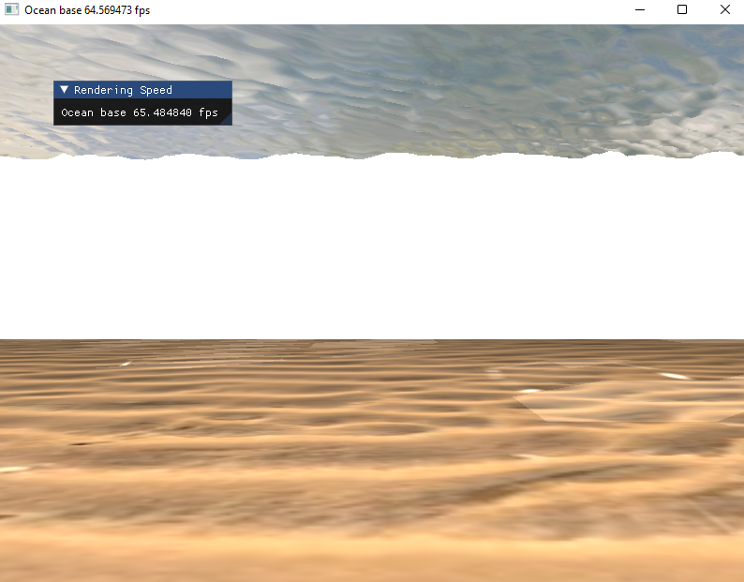
Feature 4: Deep sea color filter
After rendering the wave, the sea basin and caustics ray,
it is not really like the vision in deep sea…
Necessary to consider spectral absorption rule of the sea water.
Using framebuffer to make an extra render pass (fragment shader)

Slide 11
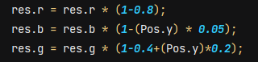
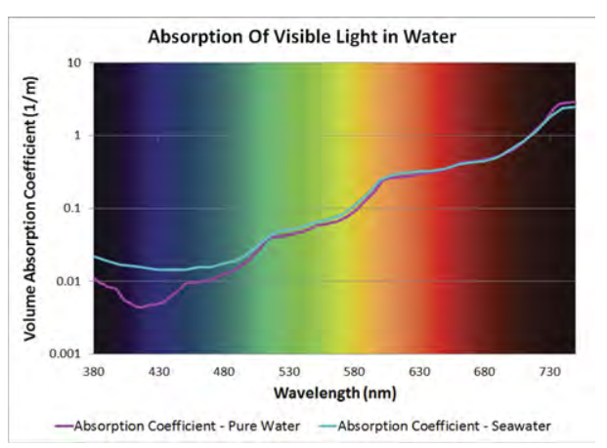
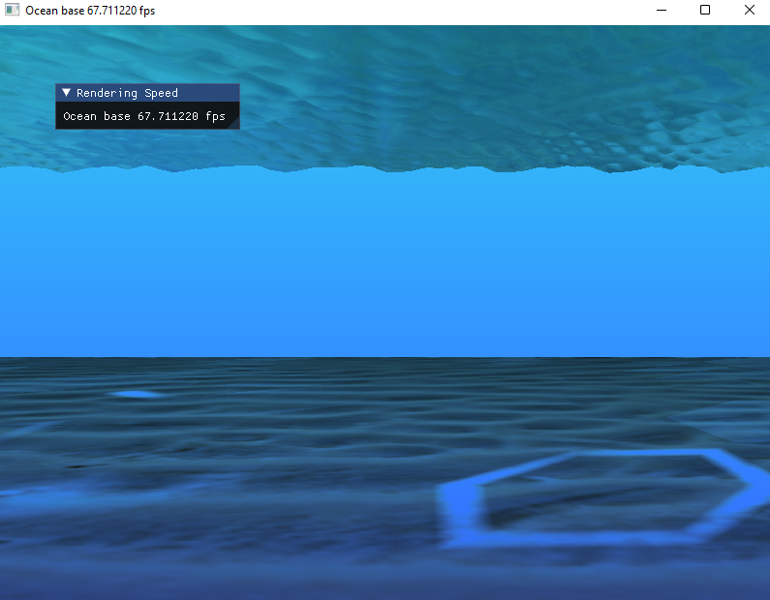
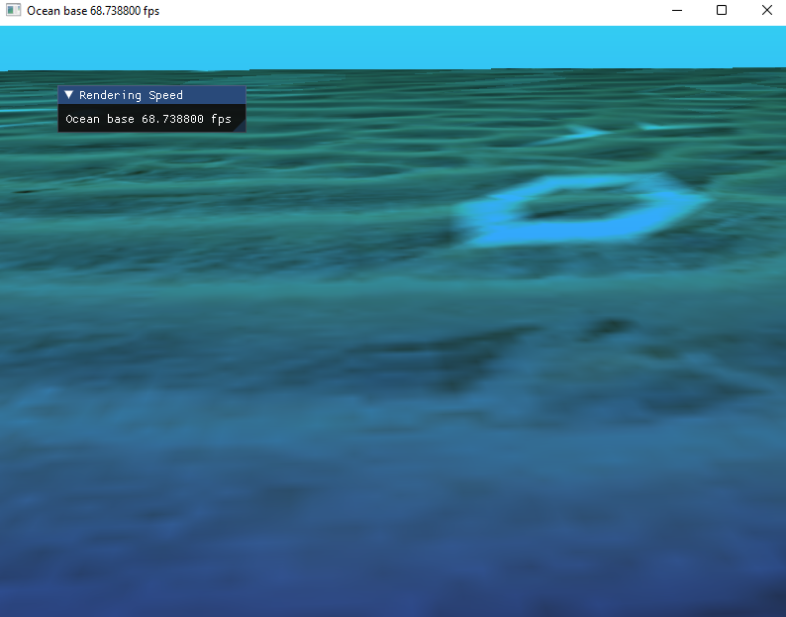
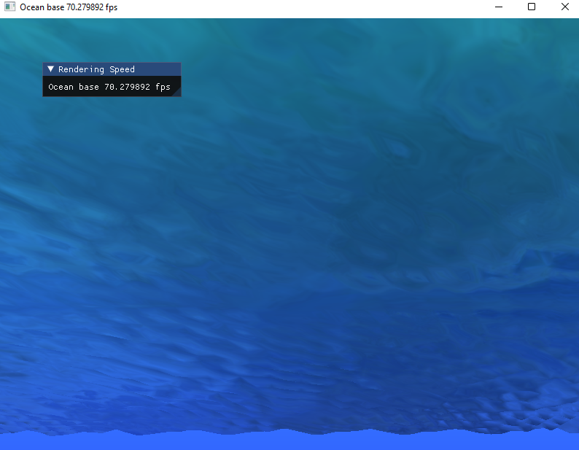
Feature 4: Deep sea color filter
We use the color map in fragment shader:
An approximated fitting followed:
https://www.deepsea.com/wp-content/uploads/2022/01/201305_Understading_Basics_Underwater_Lighting_ONT.pdf

Slide 12
Credits
Parallax mapping: Bitao Jin, Joel Kim
Caustic ray: Renhao Zhang, Yutong Liang

Slide 13
Thanks！

